Slide 1

Wave-Driven Rotary Energy Generation System
Group ID: ECS_36
Branch: ECSc
Team Members:
ANKIT KUMAR (233012)
VIBHORE KRISHNA (2330128)
SUPRIT MANGARAJ (2330127)
MUKULIKA BHATTACHARYYA (2330240)
Supervisors: Prof. MANOJ KUMAR PARIDA
School of Electronics Engineering
KIIT Deemed to be University, Bhubaneswar

Slide 2
Objective
To design and develop a scaled Oscillating Water Column (OWC) system for wave energy conversion.
To generate artificial waves using a motor-driven mechanism in a controlled environment.
To study the interaction between wave motion and air compression inside the duct.
To convert wave-induced airflow into electrical energy using a DC generator.
To analyze the relationship between wave characteristics and power output.
To implement a system for measuring and recording wave behavior in real time.
To evaluate the efficiency and feasibility of small-scale wave energy systems.
To demonstrate a practical model of renewable energy generation using ocean wave principles.

Slide 3
Innovation in the project
Implementation of a motor-driven wave generation system to simulate ocean waves in a controlled lab setup.
Design of a compact OWC model with optimized tank and air duct geometry for efficient airflow.
Integration of mechanical wave generation with electrical energy conversion using a DC motor as a generator.
Development of a cost-effective and scalable prototype using easily available components.
Real-time analysis of wave characteristics and corresponding electrical output for performance evaluation.
Combination of mechanical design, electronics, and data analysis into a single integrated system.
Adaptation of OWC principles for small-scale experimental validation, making it suitable for academic demonstration.

Slide 4
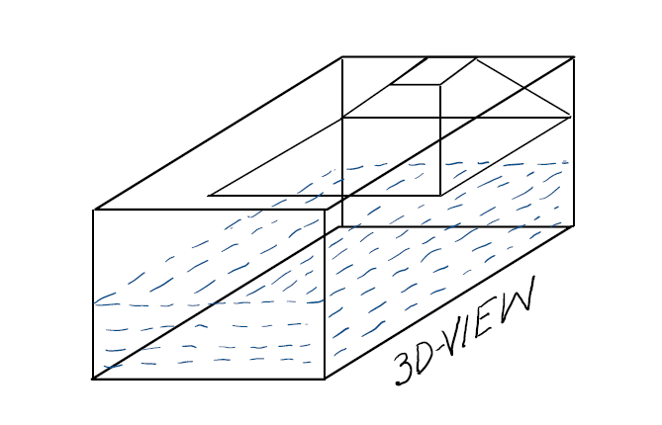
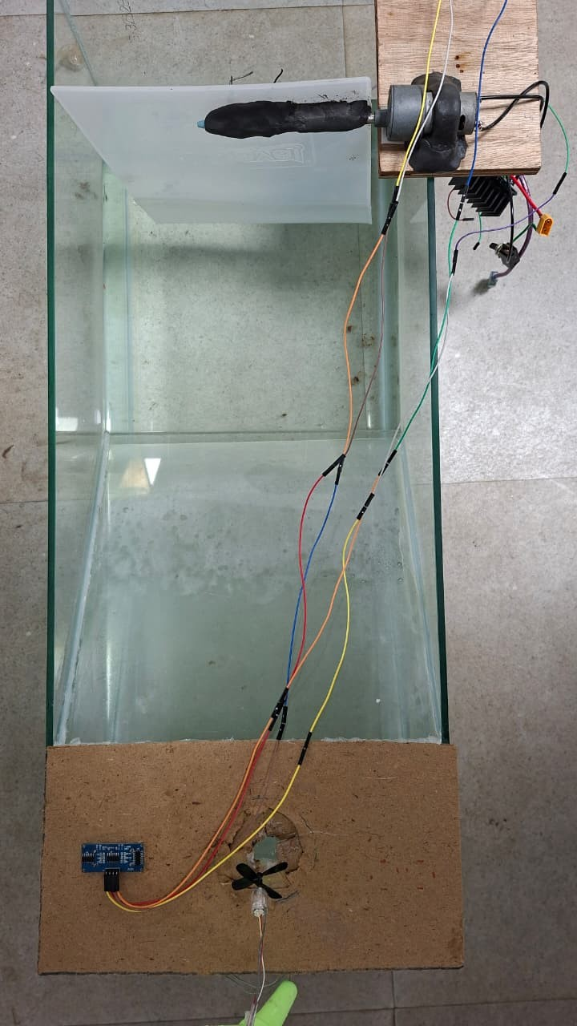
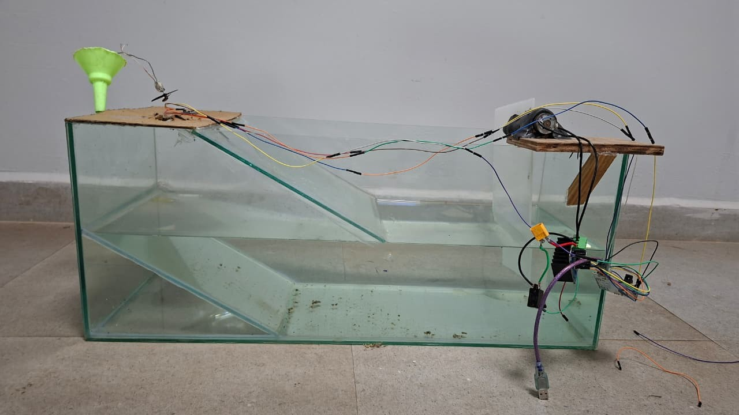
Experimental Prototype and Final Prototype
Side view
Top view

Slide 5
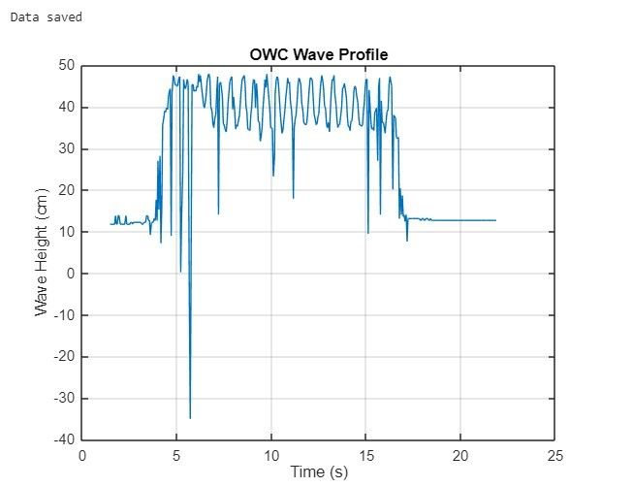
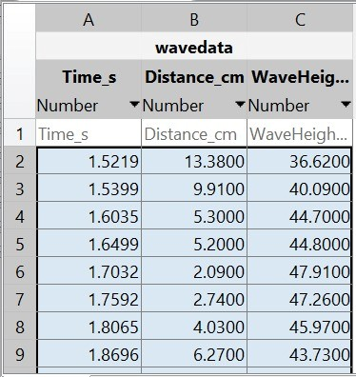
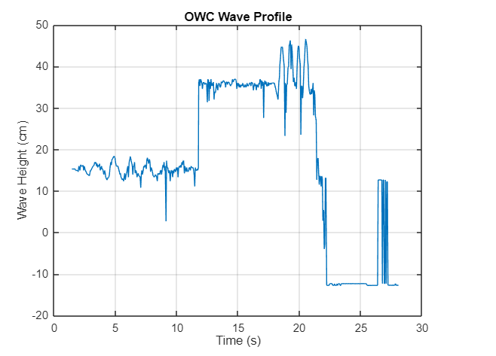
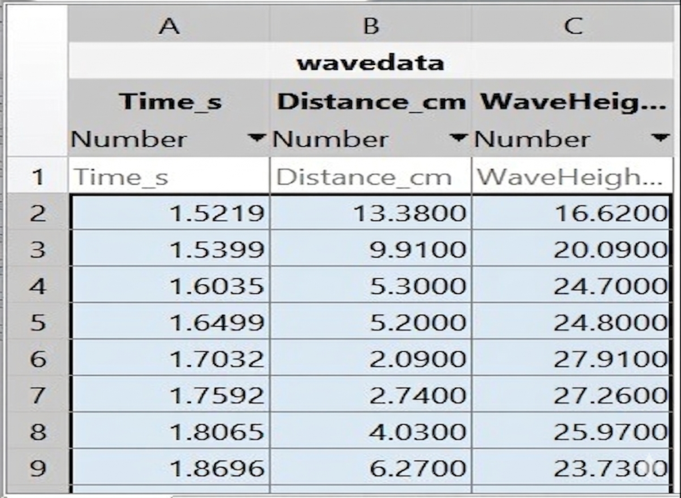
Result

Slide 6
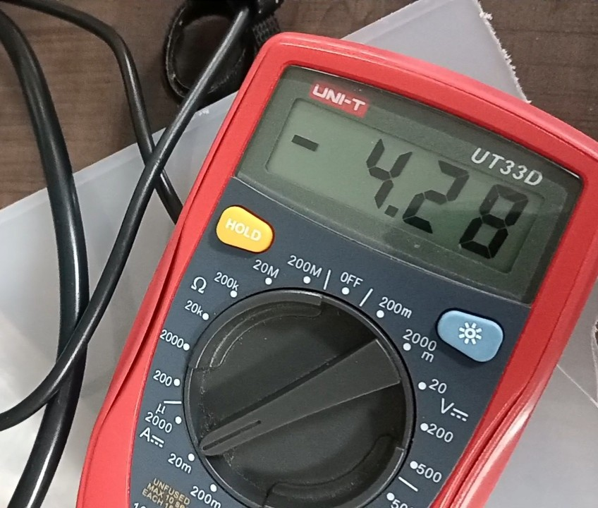
Result
Time (sec) | Current (ma)
0 | 0.0
1 | -3.4
2 | -3.6
3 | 0
4 | -4.28
5 | -4.28
6 | 0
7 | -4.2
8 | 0

Slide 7
Work to be Carried out
To use a high torque motor or optimized mechanical linkage for better force and consistent oscillation.
To design the proper Wells turbine structure for efficient current generation.
To implement a rectifier and filtering circuit for stable DC output.
To enhance the turbine/blade design for continuous and efficient rotation.
To perform detailed efficiency analysis and optimization of energy conversion.
To integrate wireless data acquisition (ESP32/IoT dashboard) for real-time monitoring.

Slide 8
References
S. M. R. Hasan, M. O. Islam, and M. M. Rahman, - “Study on Micro-Scale Ocean Wave Power Generator Using Oscillating Water Column System with Piezoelectric,”
S.-H. Kim, S.-H. Kwon, and J.-H. Lee, - “Experimental Investigations of an Elastic- Membrane Integrated Oscillating Water Column Wave Energy Converter,”
T. Waseda et al., “Ocean Upwelling System Utilizing Energy of Surface Waves,”
M. Morozov, T. Zuenko, and V. Vidal, - “Conceptual Design and Analysis of a Wave- Driven Artificial Upwelling Device,”
Z. Arifin et al., - “Selecting an Ideal Site for Oscillating-Water-Column (OWC) Wave Energy Converter for Hydrogen Production in the Southern Coast of Yogyakarta, Indonesia,”
A. Perez, M. F. Lopez, and C. B. Hernandez, - “Ocean Wave Energy-Driven Desalination Systems for Off-grid Coastal Communities in Developing Countries,”

